Slide 1
High-speed Bipedal Robot Running Using High-Speed Visual Feedback
Tomoki Tamada, Wataru Ikarashi, Daiki Yoneyama, Kazuhito Tanaka
Yuji Yamakawa, Taku Senoo and Masatoshi Ishikawa
Notes:
Jelou!
We

Slide 2
State of the Art
Zero Moment Point
Spring Loaded Inverted Pendulum
Passive Walking and Running
Notes:
Most popular methods for motion control for bipedal robots
To keep the balance of the robot.
- Zero Moment Point-based control: position the feet so that the the moments in the horizontal direction are minimized.
Very robust
Computationally expensive
Small stable region (limits movements)
- SLIP: spring-loaded inverted pendulum. Suitable for hopping robots.
Lack of versatility and high number of control parameters
- Passive walking and running: simple control and energy efficiency

Slide 3
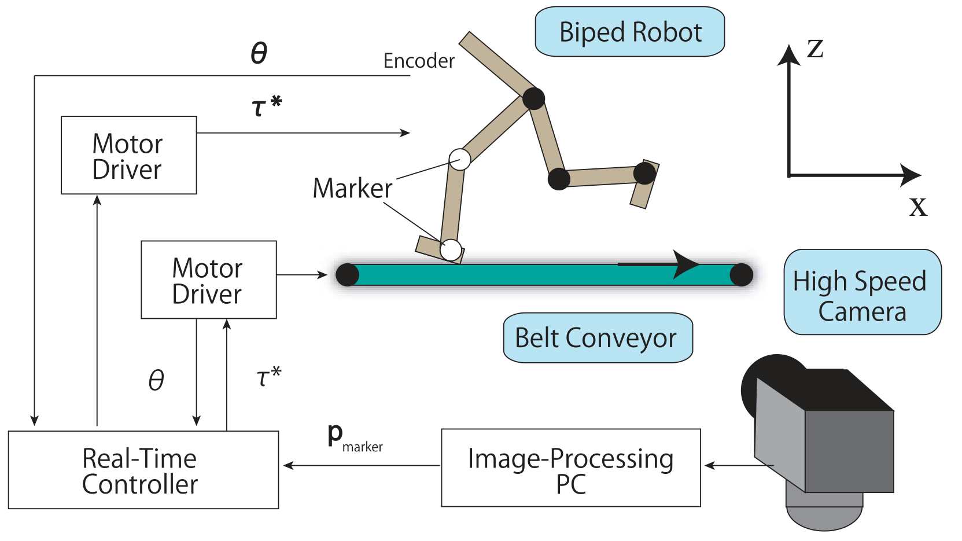
Proposed Method - Hardware

Slide 4
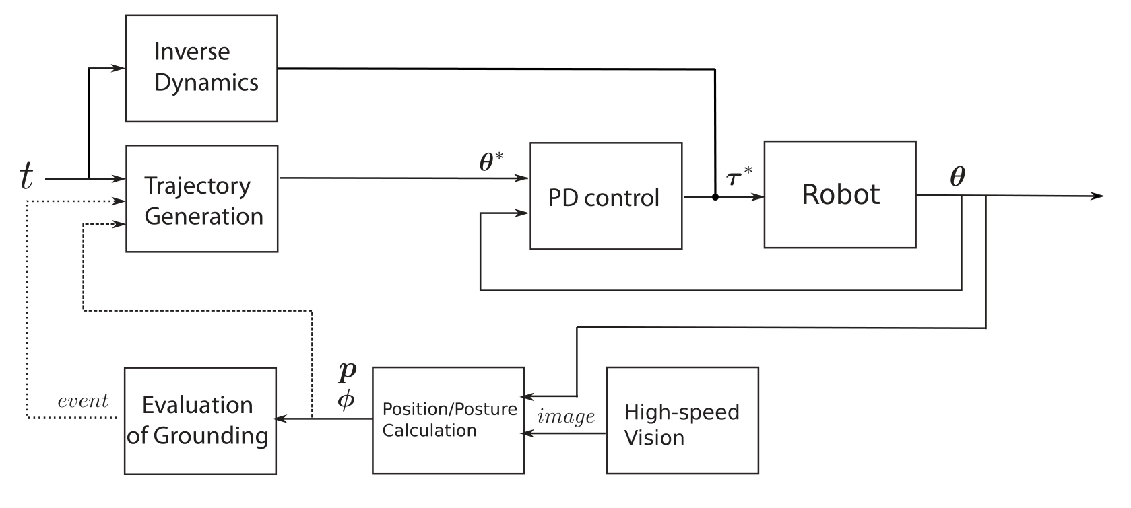
Proposed Method - Software

Slide 5
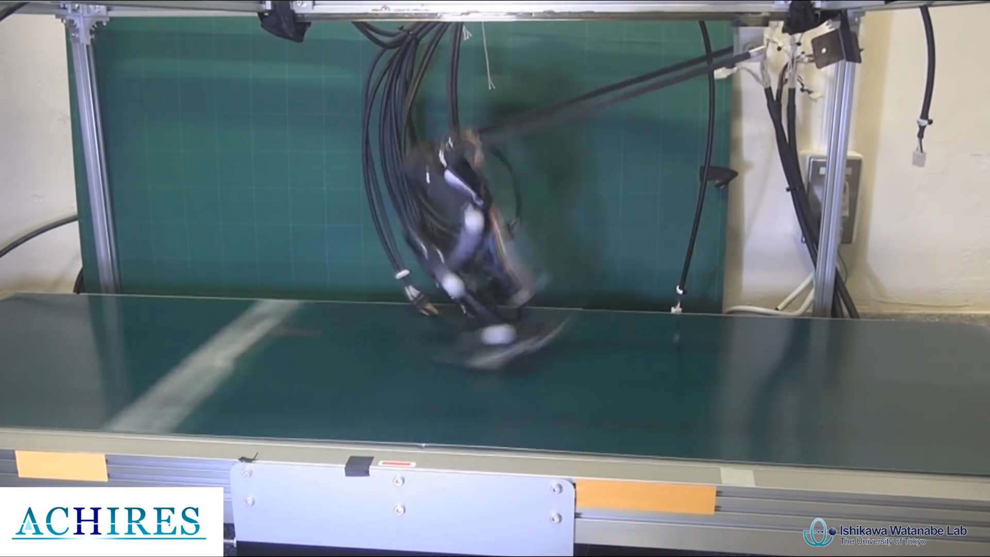
Proposed Method - Video

Slide 6
Proposed Method
Control phases
Grounded Phase
Jumping Phase
Aerial Phase
Kind of control
Joint Angle Control
Torque Control
Visual Feedback Control

Slide 7
Control Phases – Grounded
 | Support | Swing
Hip | Joint | Joint
Knee | Joint | Joint
Ankle | Joint | Joint
Joint Angle Control
$q\left(t\right)=\frac{q_{st}−q_{ed}}{t_{ed}−t_{st}}(t−t_{st}$)
𝑞(𝑡)=(𝑞_𝑠𝑡−𝑞_𝑒𝑑)/(𝑡_𝑒𝑑−𝑡_𝑠𝑡 )(𝑡−𝑡_𝑠𝑡)

Slide 8
Control Phases – Jumping
 | Support | Swing
Hip | Joint | Joint
Knee | Torque | Joint
Ankle | Torque | Joint
Torque Control
Max torque defines height of the jump
Step function

Slide 9
Control Phases – Aerial
 | Support | Swing
Hip | VF | VF
Knee | Joint | Joint
Ankle | Joint | Joint
Visual Feedback Control
Calculate the angle of the not tracked leg based on:
1. $θ_{leg} θ_{body}$
2. Inertia of the bodies
Calculate the angle of the not tracked leg based on:
1. 𝜃_𝑙𝑒𝑔 𝜃_𝑏𝑜𝑑𝑦
2. Inertia of the bodies

Slide 10
Results
Runs!
The correction in the torso reduces the power peak motor
It is the fastest in the world based on the Froude Number
Further work: include the cameras in the robot

Slide 11
Running Robot Phides
J.G.Daniël Karssen and Martijn Wisse

Slide 12
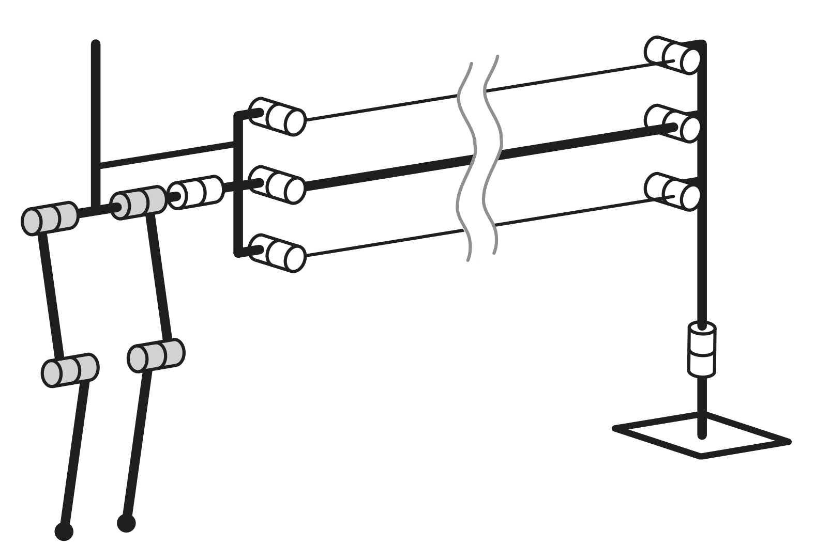
Overall Design
6 DoF
Fixed torso
No ankles

Slide 13
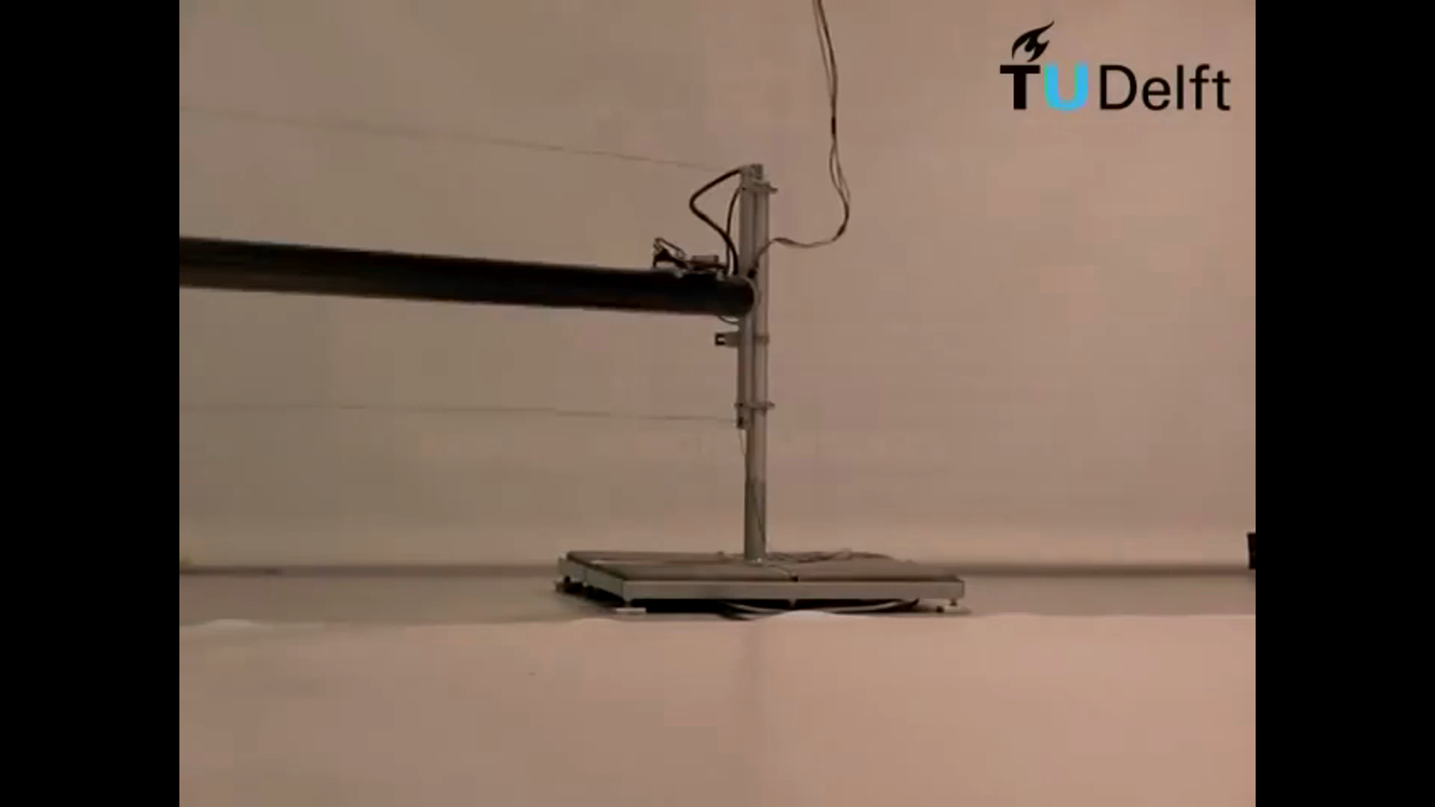
Video!

Slide 14
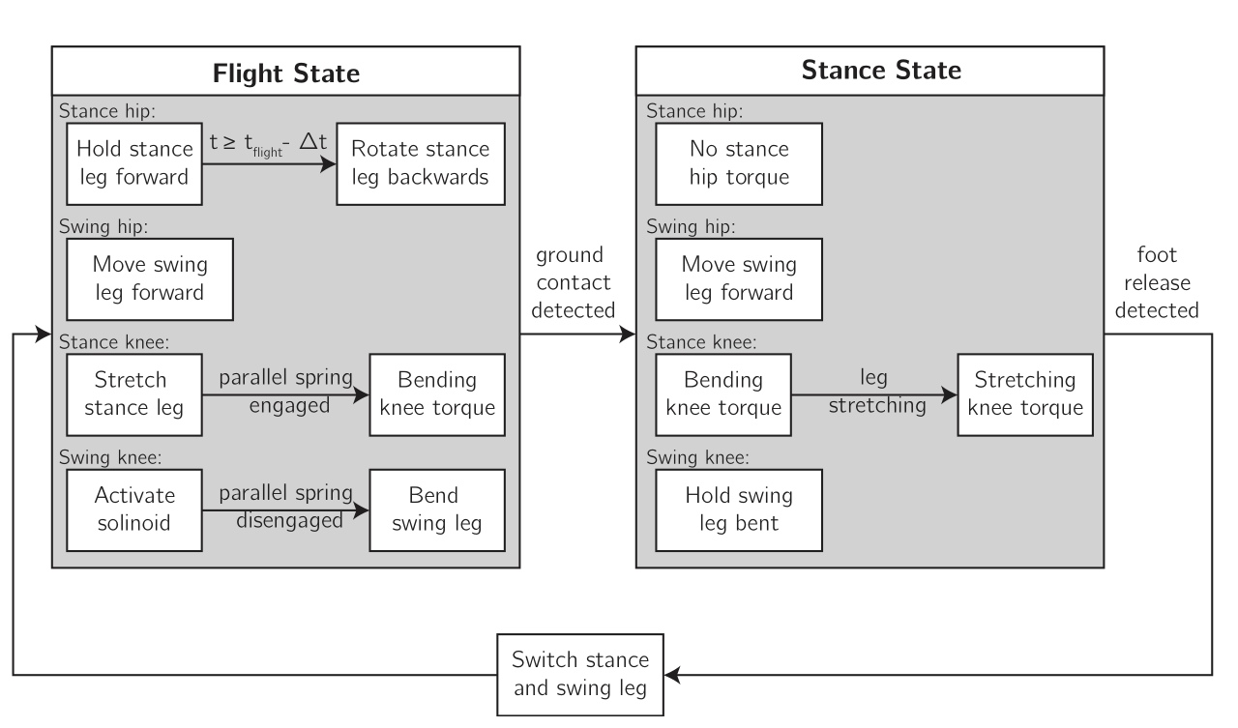
Electronics, Control and Mechanics
Control
Electronics: on board central PC, 5 slaves
Mechanics: effective prismatic spring between hip and ankle

Slide 15
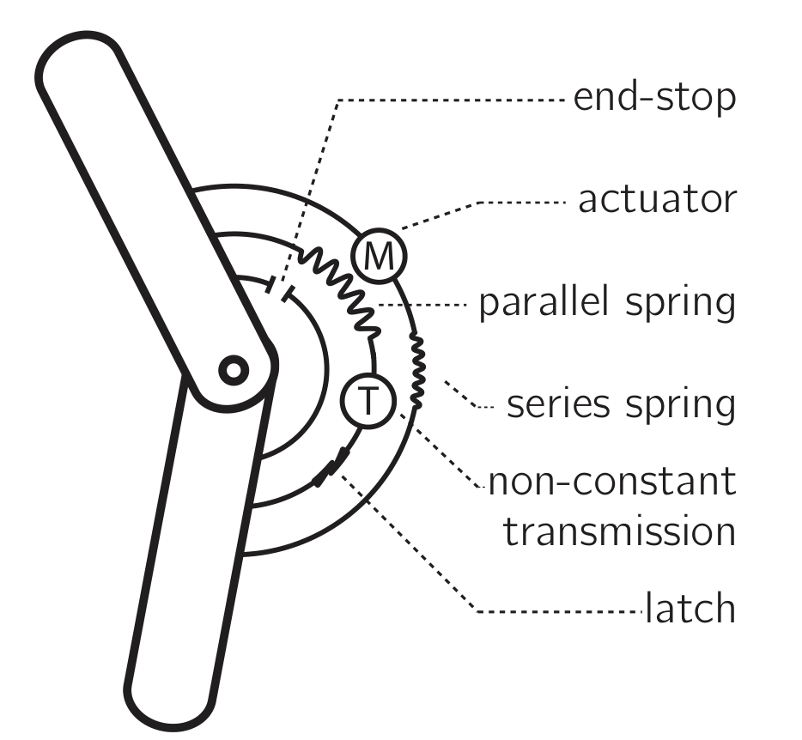
Mechanical design of the knee

Slide 16
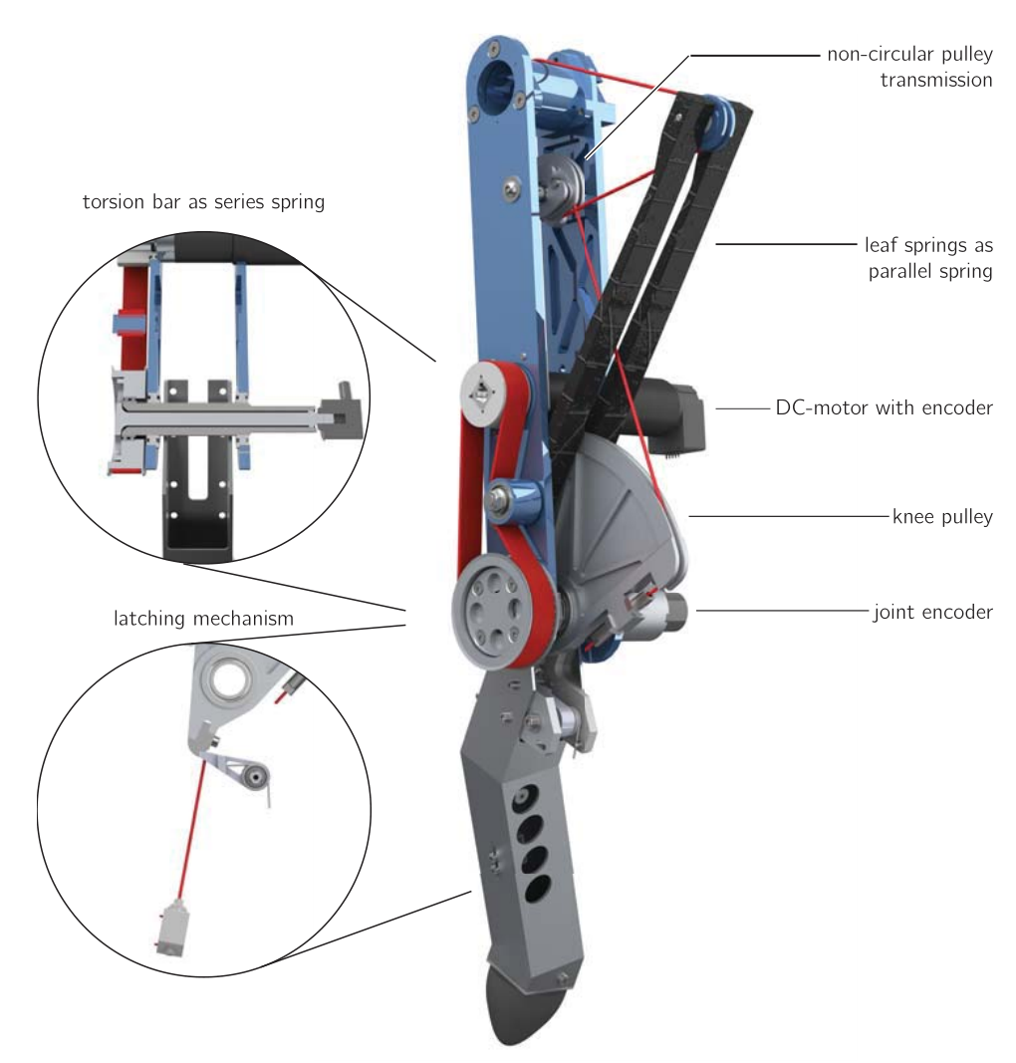
Mechanical design of the knee

Slide 17
Results
Runs!
Parallel spring reduces the required power peak motor
Longest time of flight
Future work: study swing retraction to improve efficiency

Slide 18
Overall conclusions
Design principles for embodied agents
Comprehensive design of bipedal robots = control + mechanics + electronics

